Slide 1


CMR TECHNICAL CAMPUS
UGC(Autonomous)
Accredited by NBA & NAAC with ‘A’ Grade
Approved by AICTE , New Delhi & JNTU, Hyderabad.
Department of Computer Science Engineering
A Major Project on
BLOCKCHAIN FOR THE MANAGEMENT OF INTERNET OF THINGS DEVICES IN THE MEDICAL INDUSTRY
Presented by:
P. Indhu 217R1A0544
K. Mahipal 217R1A0528
E. Mahesh 217R1A0520
Under the Guidance of
Ms Tabeen Fatima
(Assistant Professor)

Slide 2
TABLE OF CONTENTS
Introduction
Abstract
Existing System
Disadvantages
Proposed System
Advantages
System Requirements
Novelty of the project
System Architecture
Modules
UML Diagrams
Algorithms
Output Screenshots
Result Analysis
Conclusion
Future Scope
Algorithms
Sample Code
Output Screenshots
Result Analysis
Conclusion
Future Scope
References
Github Link

Slide 3

INTRODUCTION
The integration of blockchain technology within the management of Internet of Things (IoT) devices in the medical industry represents a groundbreaking advancement in healthcare.
Blockchain, with its decentralized and immutable ledger capabilities, offers a robust solution to the challenges of data integrity, interoperability, and patient privacy.
Convergence of IoT and blockchain not only promises improved patient outcomes through real time monitoring and analytics but also sets the stage for innovative healthcare solutions that prioritize data security and patient empowerment in an increasingly interconnected world.
By leveraging blockchain's decentralized and secure nature, we can enhance patient safety, improve data transparency, and streamline healthcare operations.

Slide 4
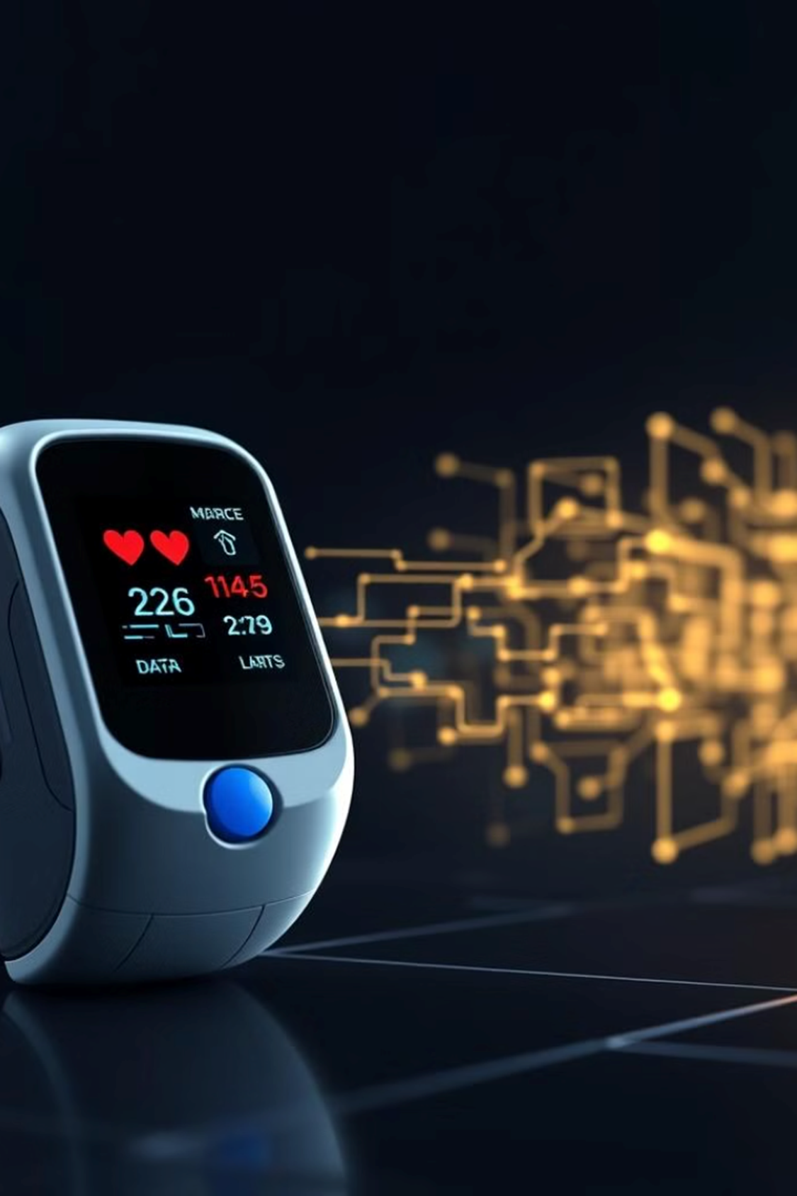
ABSTRACT
Blockchain based framework designed to manage IoT devices in the medical industry. By utilizing blockchain’s decentralized architecture, the proposed system ensures secure data transmission, enhances patient privacy, and provides a transparent audit trail for all interactions involving medical devices. Additionally, the framework addresses interoperability issues by standardizing data formats.

Slide 5
EXISTING SYSTEM
Several existing systems utilize blockchain technology for managing Internet of Things (IoT) devices in the medical industry, enhancing security, data integrity, and interoperability.
Centralized Management
Current IoMT systems rely on centralized servers for data storage and management, leading to vulnerabilities and single points of failure.

Slide 6
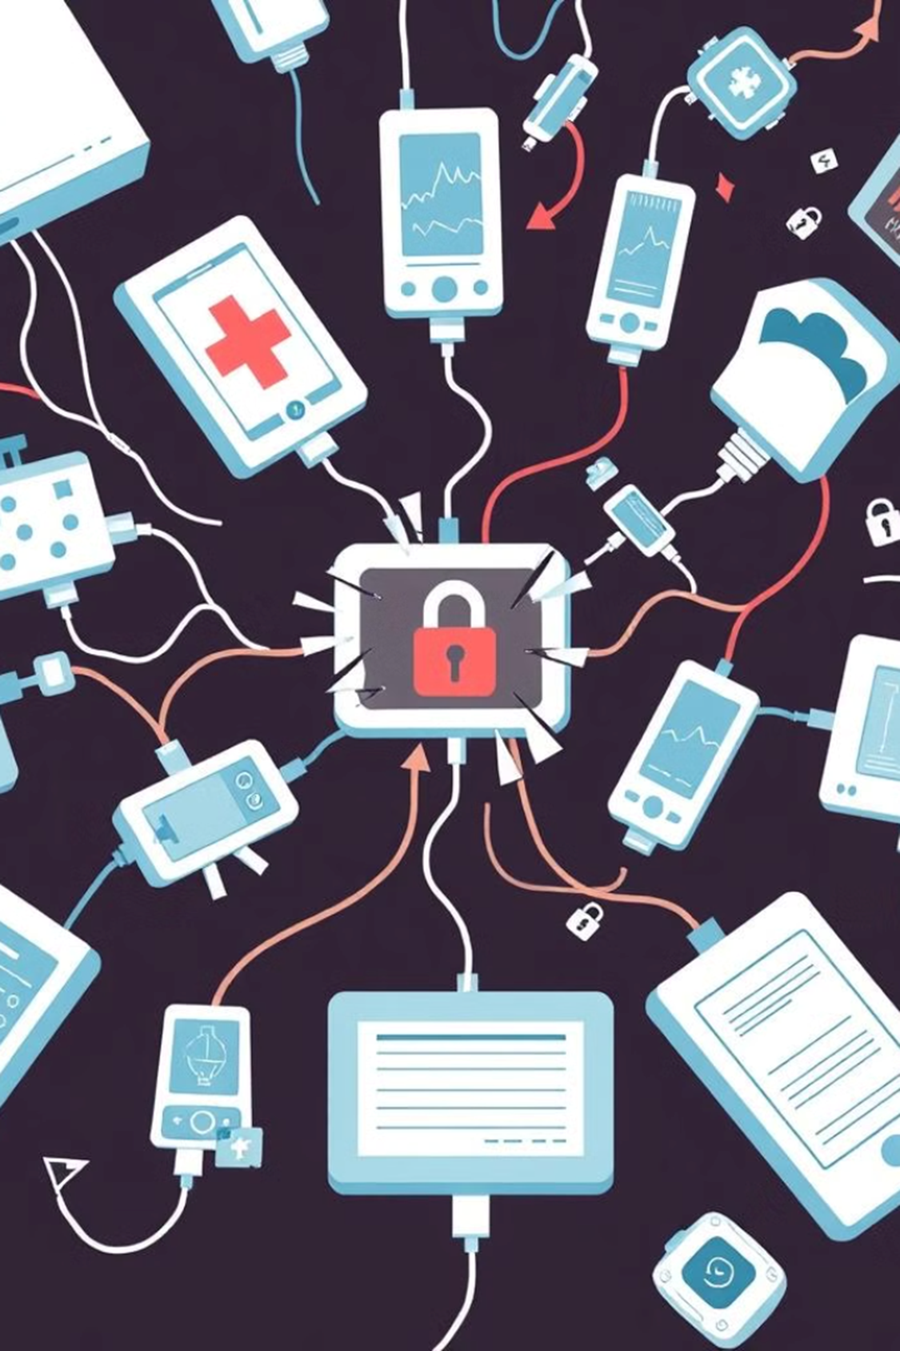
DISADVANTAGES
Scalability Issues
Blockchain networks can face challenges in scalability, particularly when handling large volumes of data generated by numerous IoT devices.
Interoperability Challenges
Integrating blockchain solutions with existing healthcare systems and IoT devices can be complex.
Data Privacy Concerns
Centralized servers are prone to data manipulation, making it challenging to ensure data accuracy and authenticity.

Slide 7
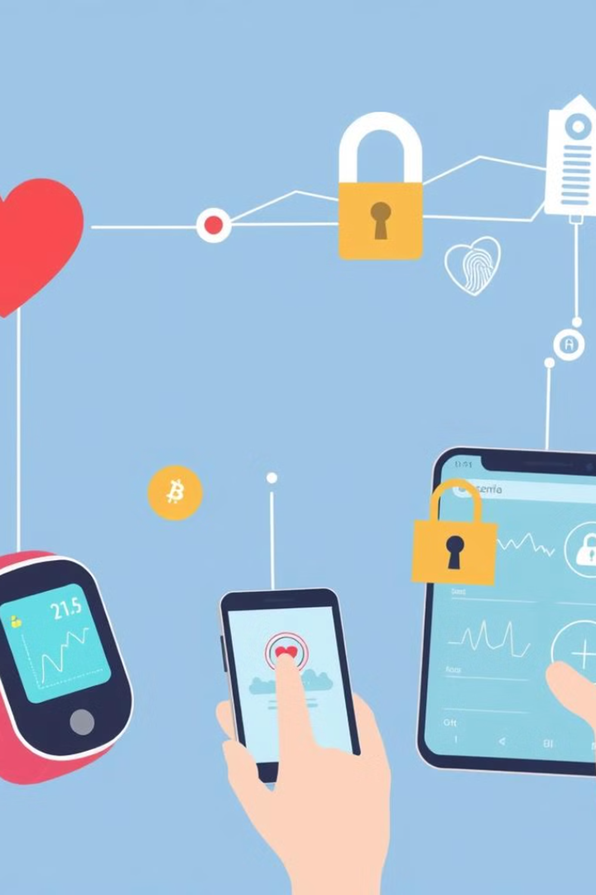
PROPOSED SYSTEM
This system utilizes a decentralized blockchain network to securely store and share data collected from various IoT devices, such as wearable health monitors, smart medical devices, and remote patient monitoring systems.

Slide 8

ADVANTAGES
Enhanced Security and Data Integrity
Improved Interoperability
Real Time Data Sharing

Slide 9
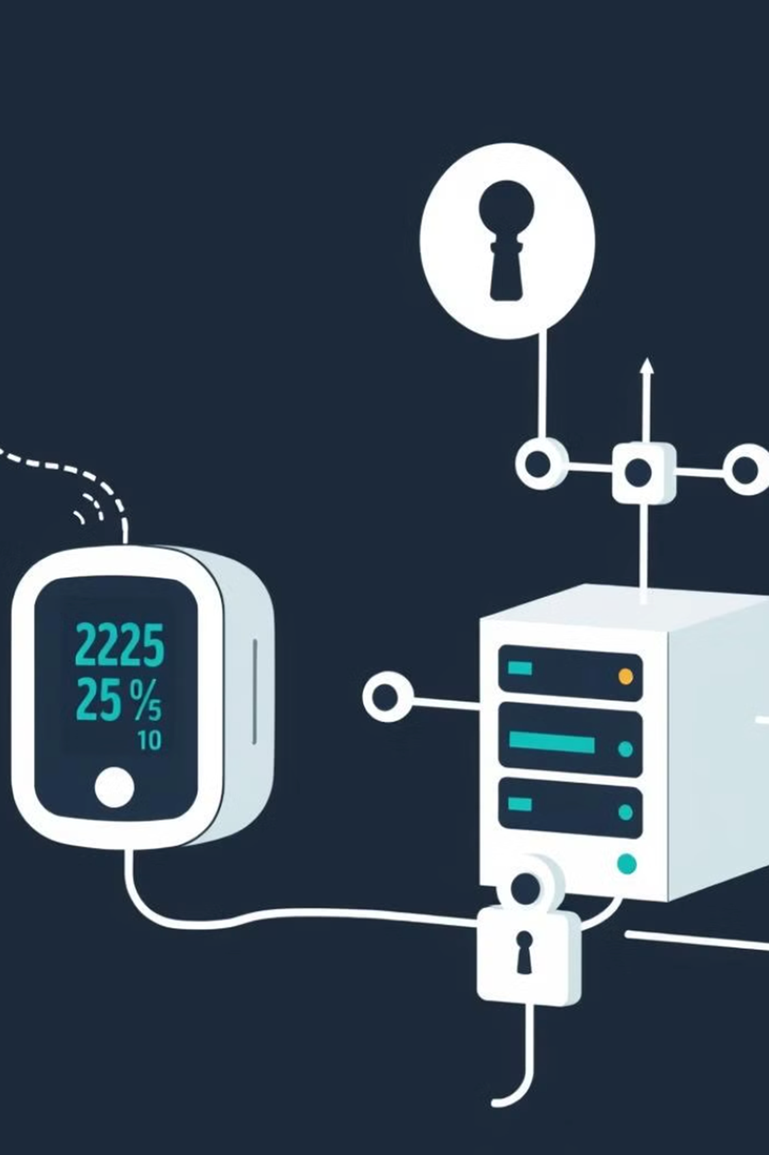
SYSTEM REQUIREMENTS
HARDWARE REQUIREMENTS
Processor : Intel i5
RAM : 4 GB(min)
Hard Disk : 20 GB
SOFTWARE REQUIREMENTS
Operating system : Windows 7 Ultimate.
Coding Language : Python 3.7

Slide 10

NOVELTY
Combines blockchain’s decentralized security with IoT medical devices.
Unique digital identity for each device, enabling secure and authenticated interactions
Blockchain can facilitate seamless communication between different IoT devices.

Slide 11
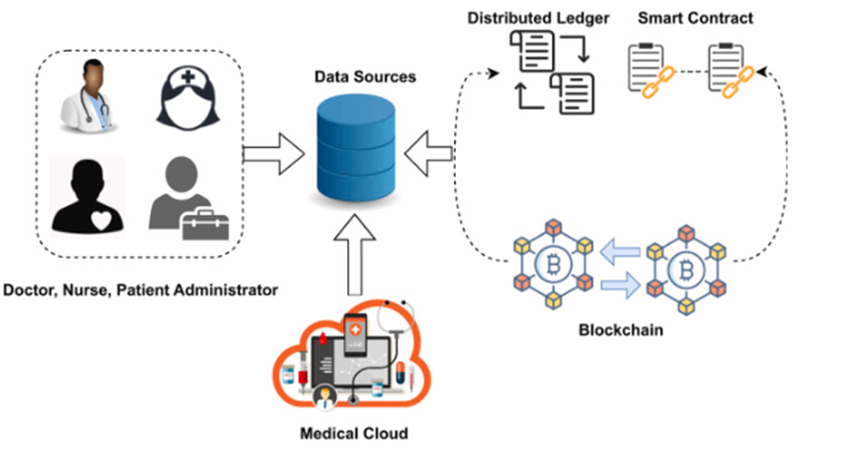
SYSTEM ARCHITECTURE

Slide 12
MODULES
Generate Medical IOT Sensors: using this module we will generate IOT sensors.
Generate Private & Public Keys: using this module will generate ECC and zero knowledge keys.
Start Simulation: using this module we will select one IOT as patient sensor and the randomly generate BP and Heart rate and then encrypt details using AES and the generate ECC and ZKP signatures and then send packet to Hospital. Hospital will verify signatures and upon verified will save packet to Blockchain.
Verification Time Chart: using this module we will plot ECC and ZKP verification time comparison chart.
Read Data from Blockchain: using this module we will read all patients data stored in Blockchain and display to Hospital employees.

Slide 13
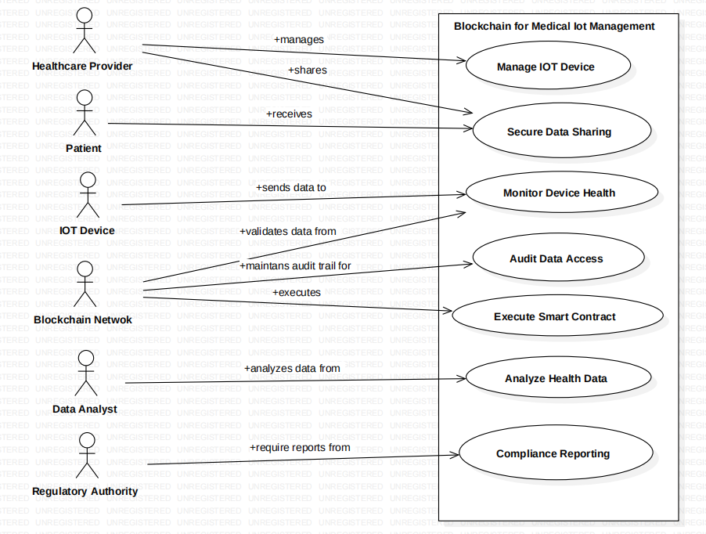
UML DIAGRAMS
USECASE DIAGRAM

Slide 14
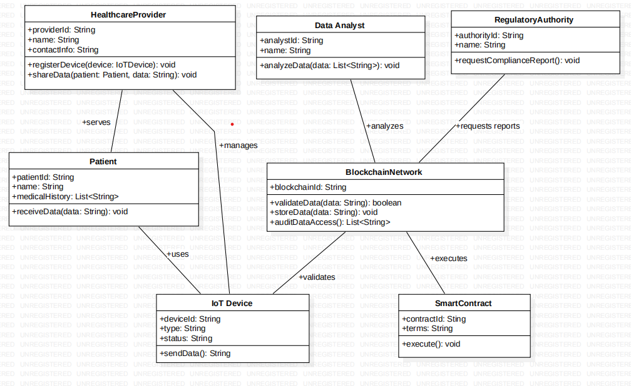
CLASS DIAGRAM

Slide 15
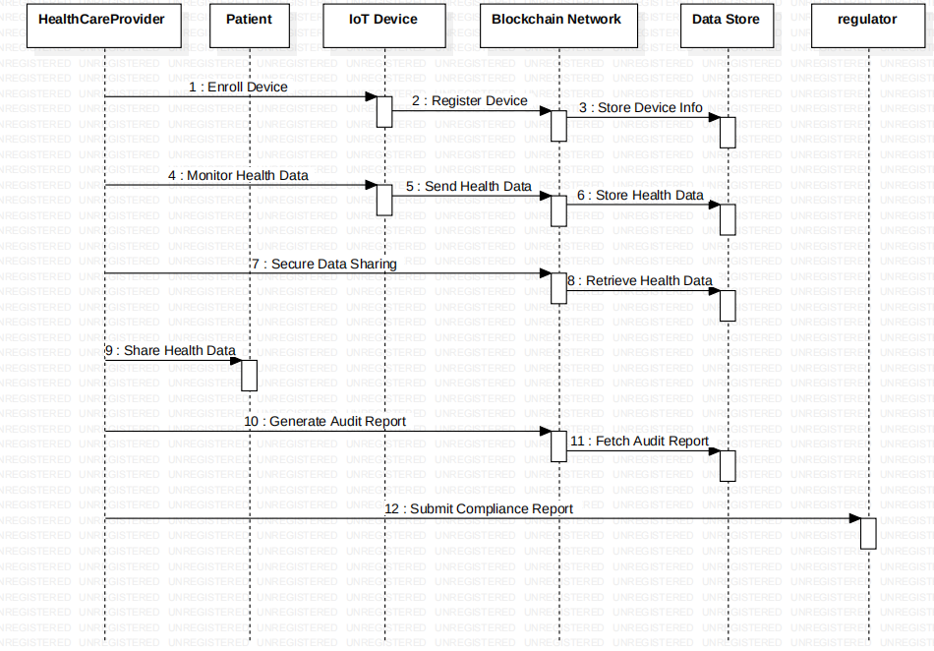
SEQUENCE DIAGRAM

Slide 16
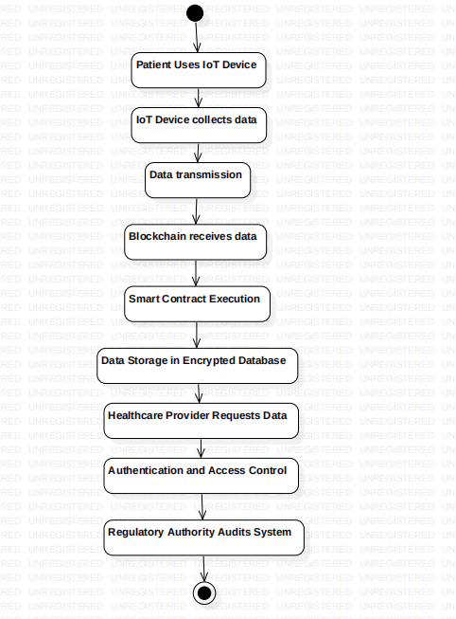
ACTIVITY DIAGRAM

Slide 17
ALGORITHMS
Advanced Encryption Standard (AES)
Advanced Encryption Standard (AES) is a highly trusted encryption algorithm used to secure data by converting it into an unreadable format without the proper key.
This data security measure is efficient and widely implemented in securing internet communication, protecting sensitive data, and encrypting files.

Slide 18
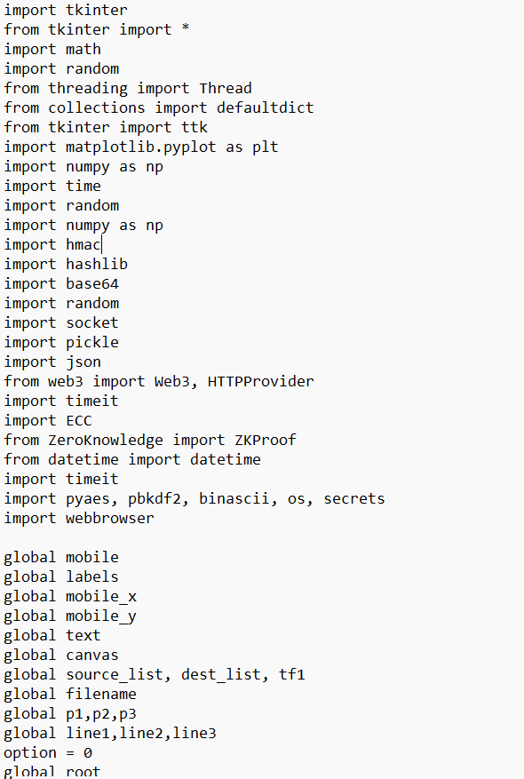
SAMPLE CODE

Slide 19
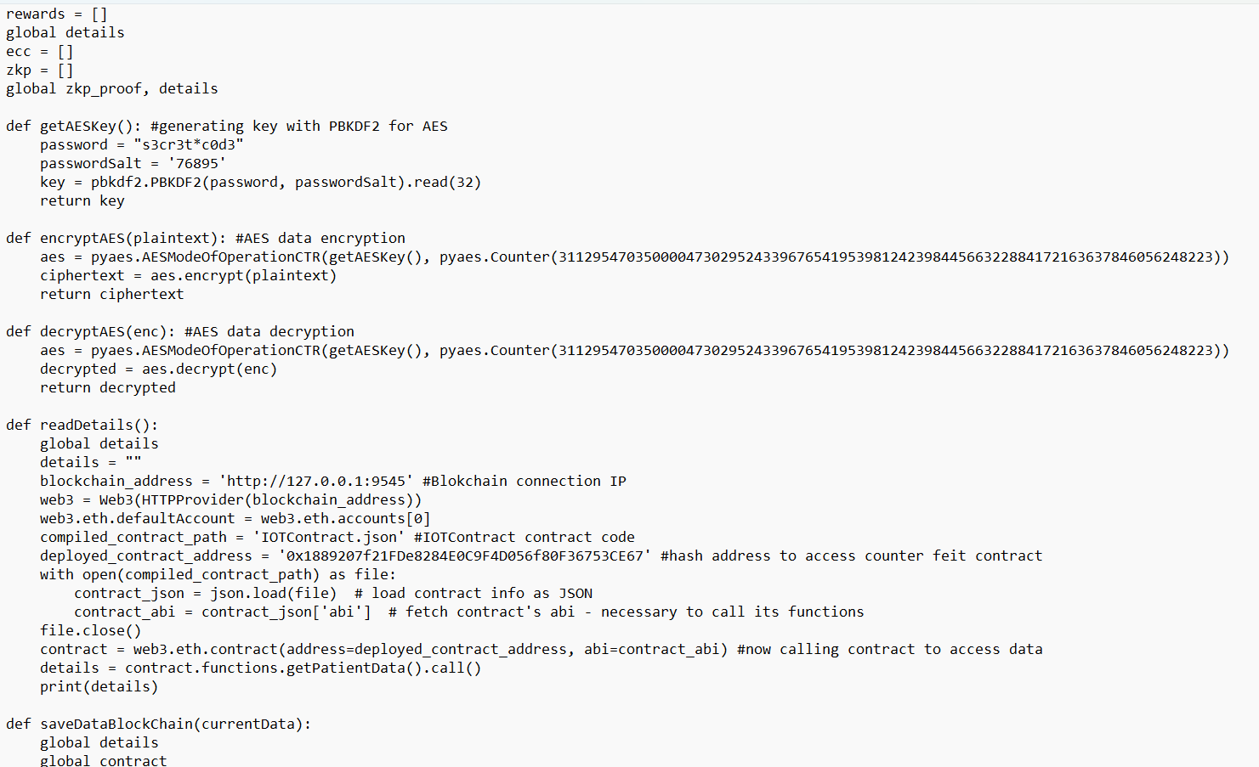

Slide 20
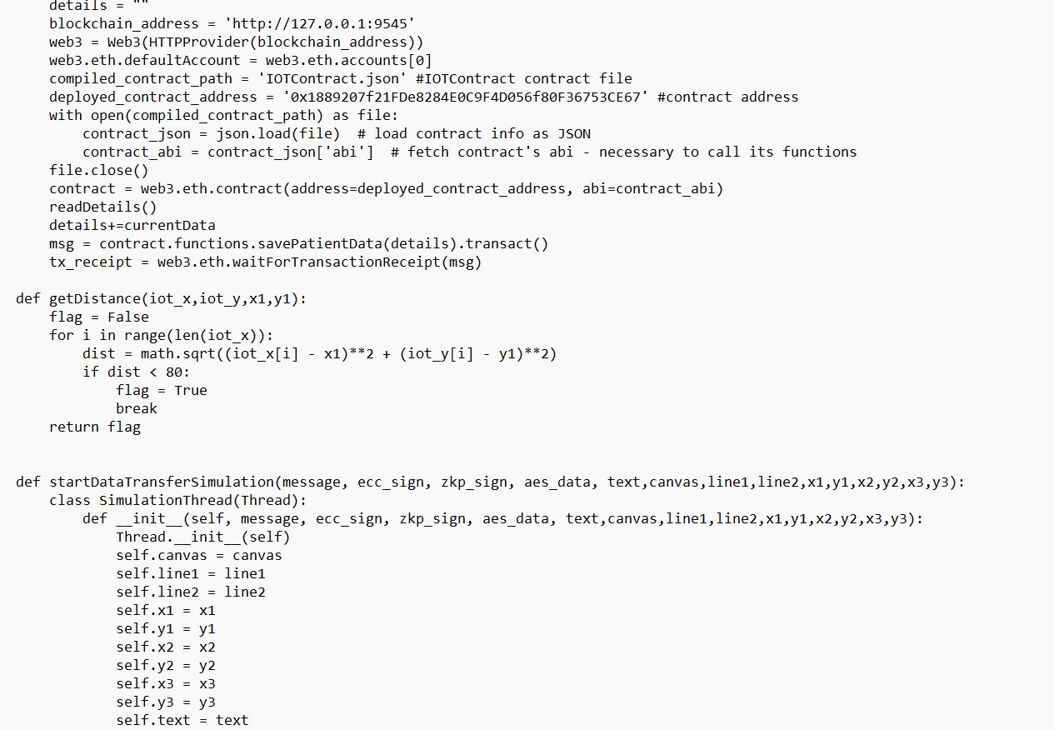

Slide 21
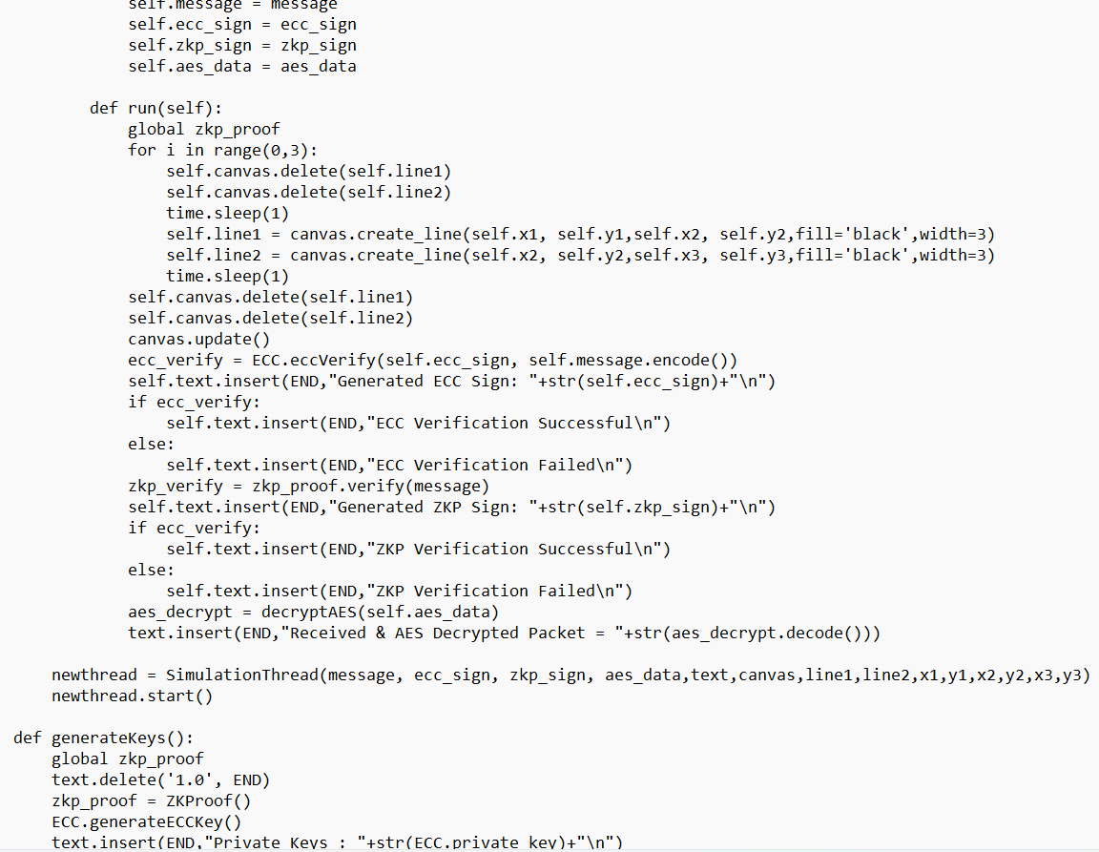

Slide 22
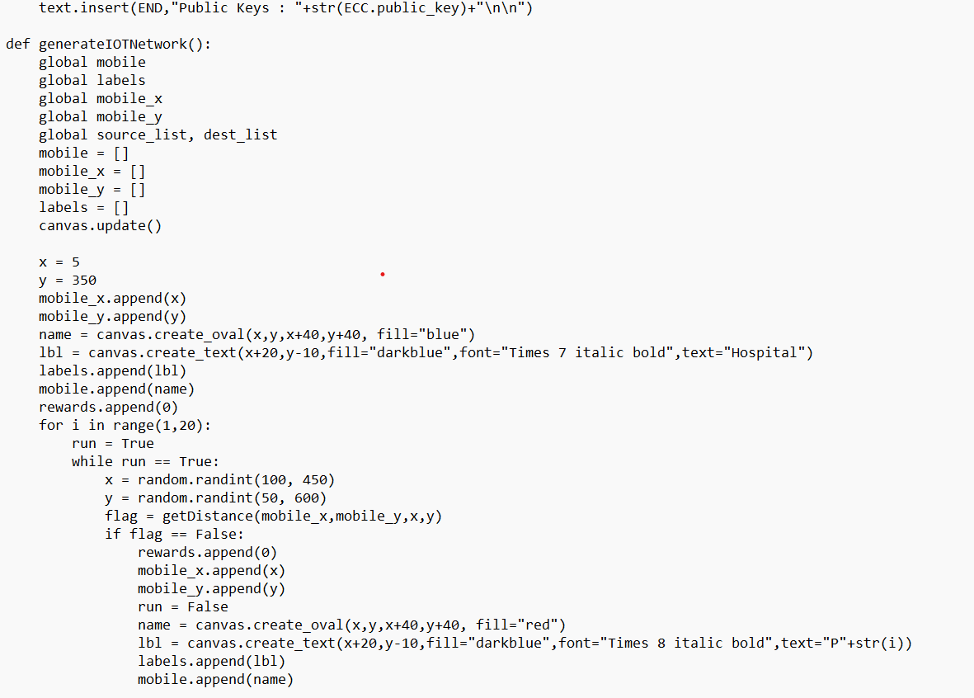

Slide 23
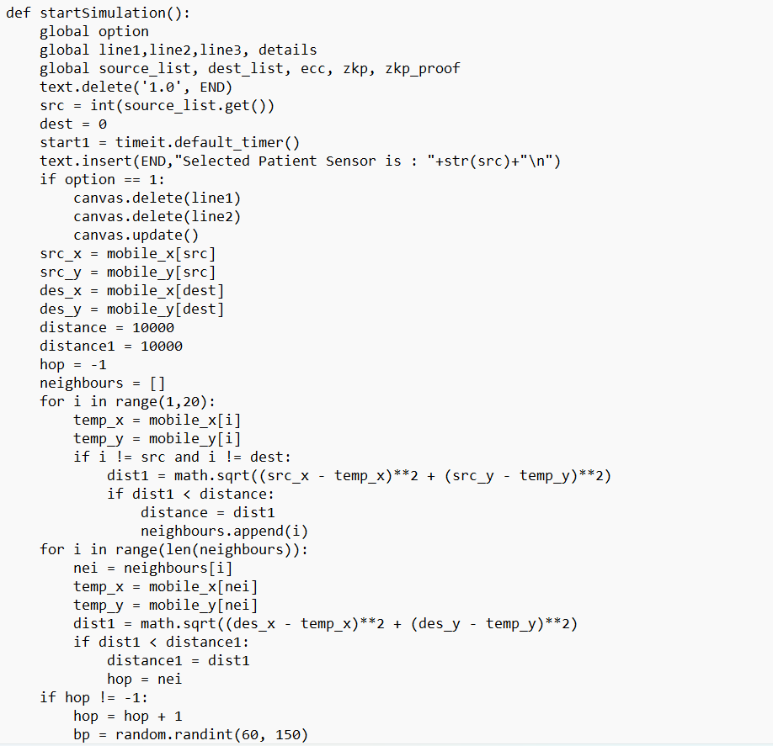

Slide 24
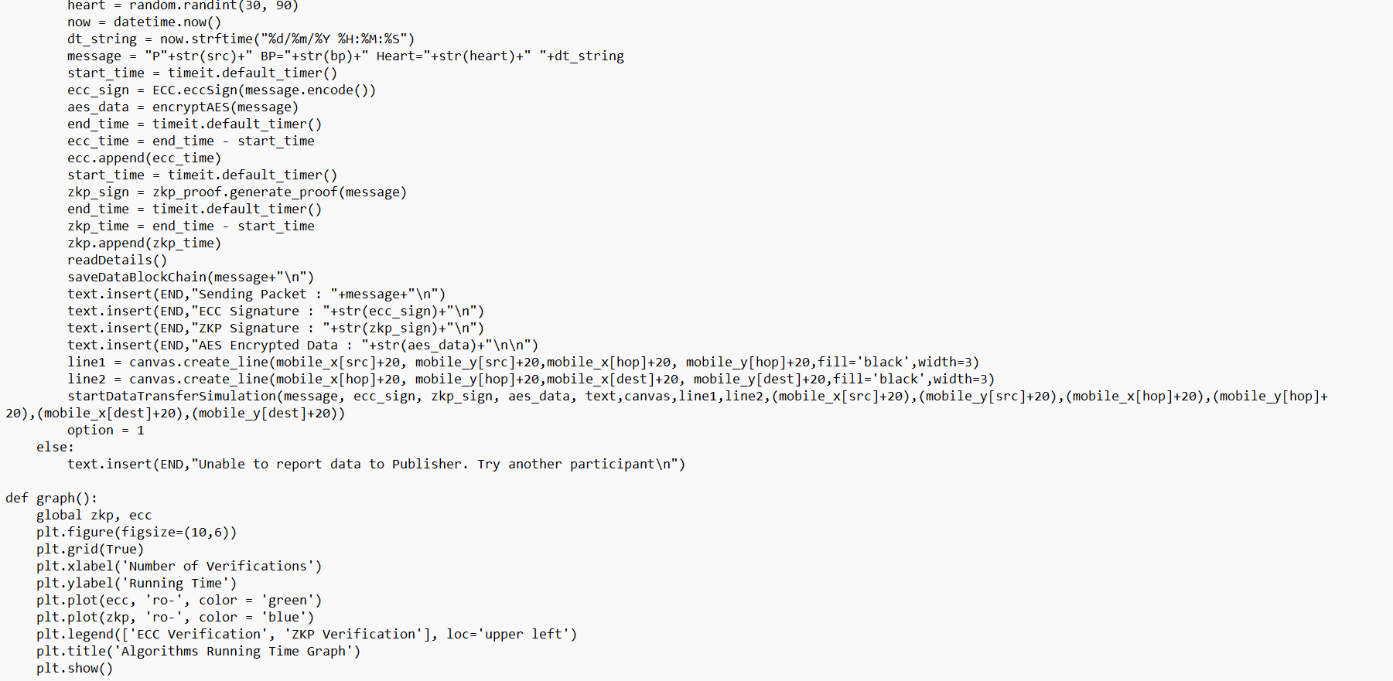

Slide 25
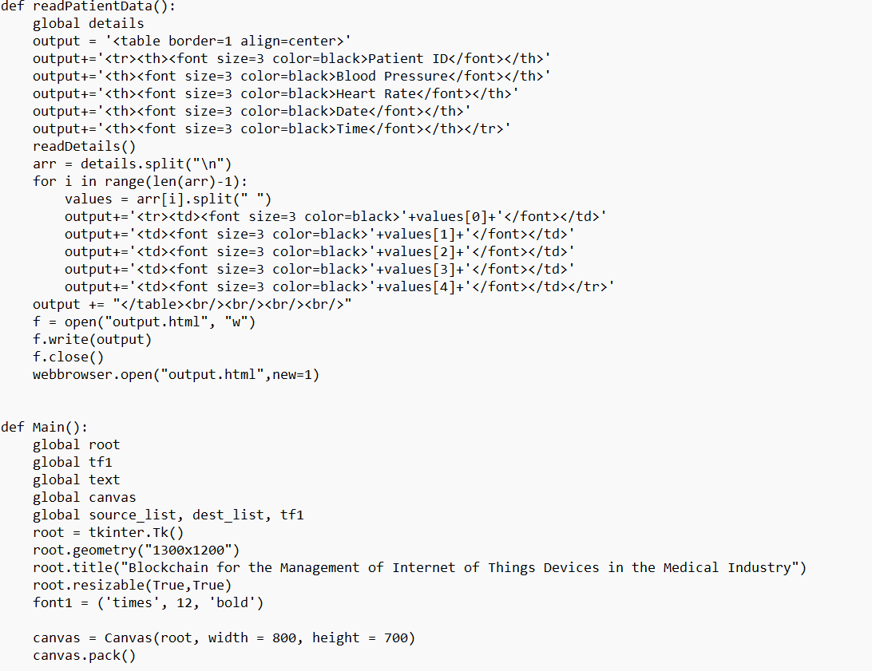

Slide 26
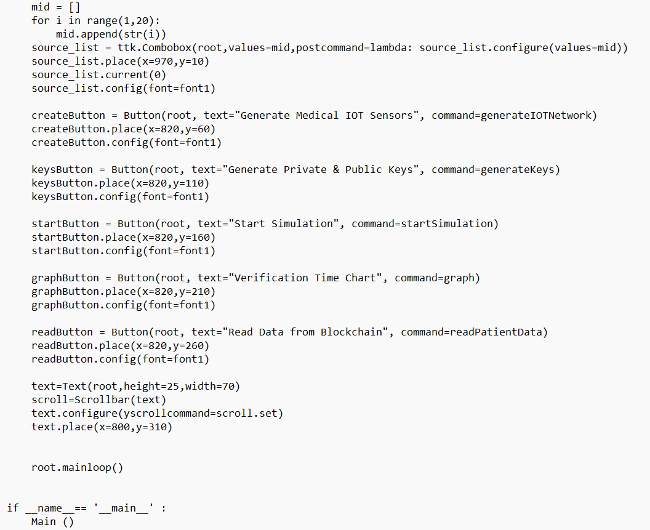

Slide 27
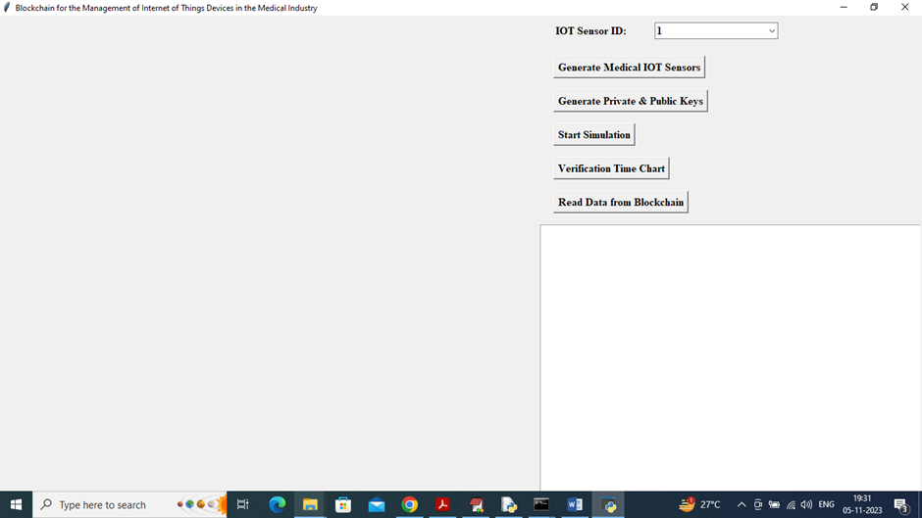
OUTPUT SCREENSHOTS
To run project double click on ‘run.bat’ file to get below screen
In above screen click on ‘Generate Medical IOT Sensors’ button to generate IOT sensors and get below page

Slide 28
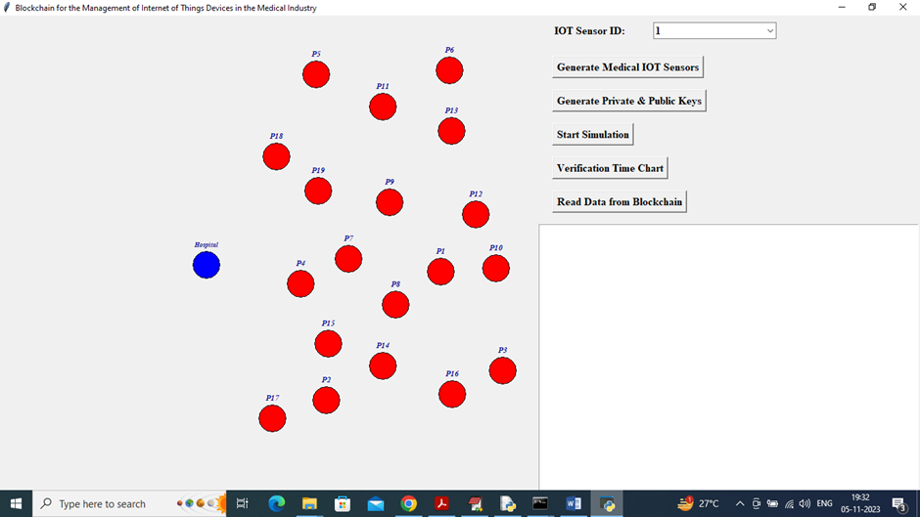
In above screen all red colour circles are the patients IOT sensors and blue colour circle is the Hospital Blockchain server and now click on ‘Generate Private & Public Keys’ button to generate keys and get below output

Slide 29
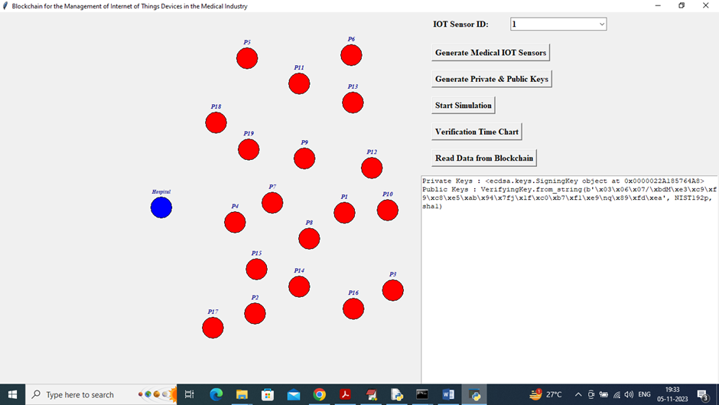
In above screen in text area we can see generated keys and now from first drop down box you can select some sensor ID and then click on ‘Start Simulation’ button to send packet to hospital node

Slide 30
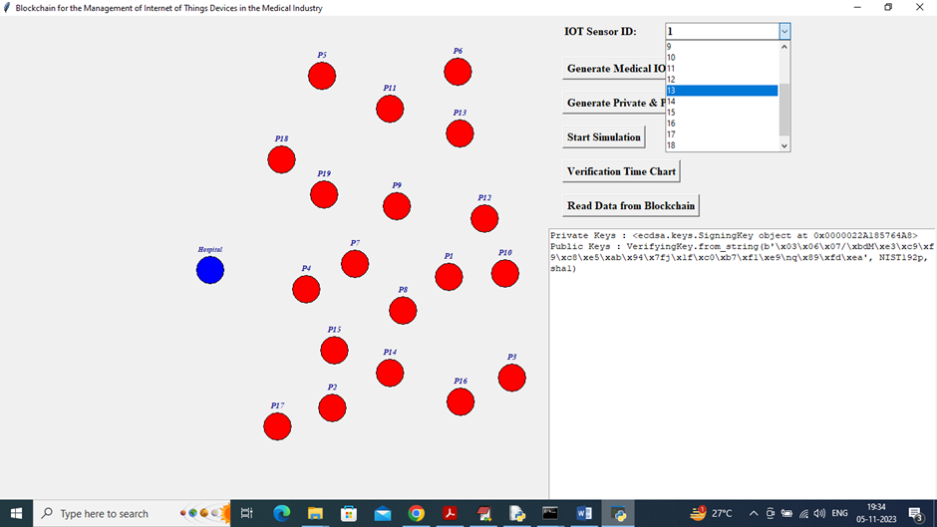
In above screen selecting patient sensor as 13 and now click on ‘Start Simulation’ button to get below output

Slide 31
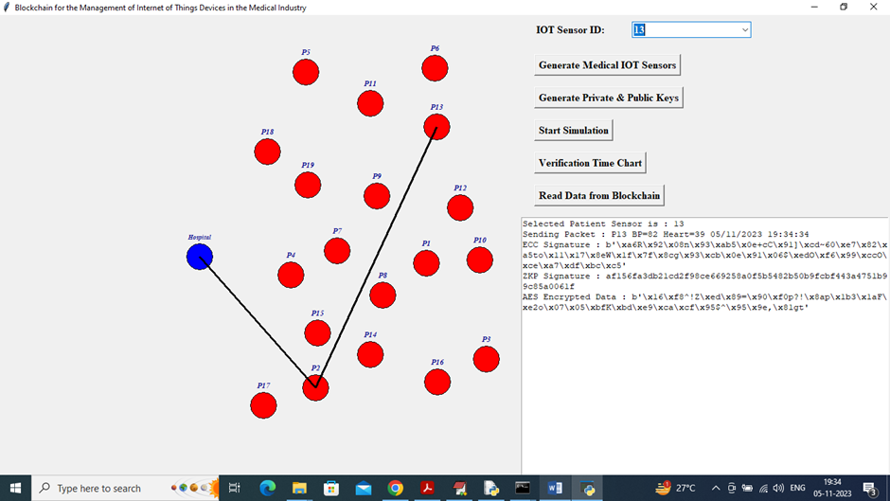
In above screen P13 is sending packet to sensor which is nearest and hospital and then that sensor will send to hospital. In text area we can see generated signatures and can see encrypted data. After receiving data hospital will perform verification and then will get below output

Slide 32
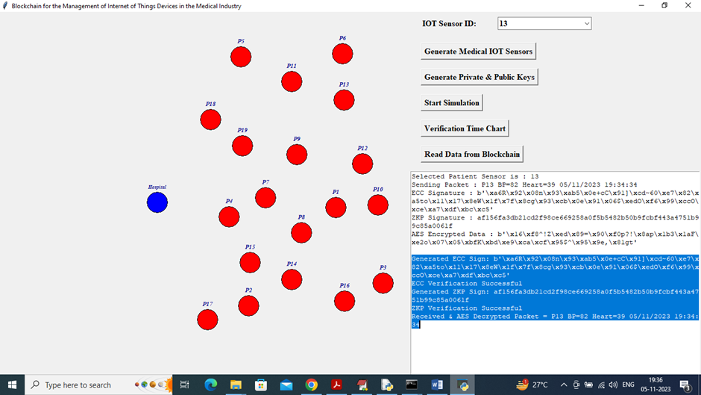
In above screen in blue colour text we can see verification output and similarly you can select patient sensor and send to hospital for storage and below is another example

Slide 33
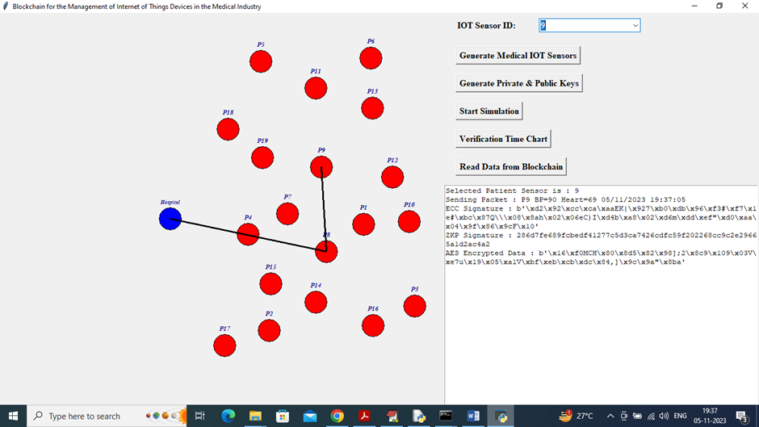
In above screen P9 sending to hospital

Slide 34
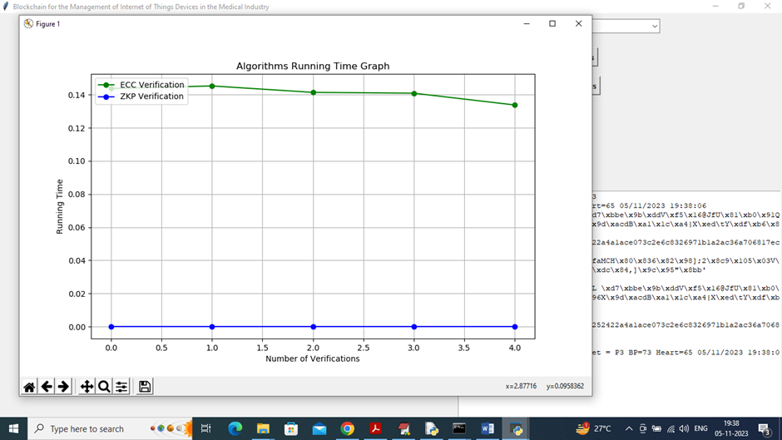
In above graph x-axis represents ‘Number of Verification’ and y-axis represents computation time. Blue line represents ZKP verification time and green line represents ECC verification time and in both algorithms ZKP (zero knowledge) us taking less time. Now close above graph and then click on ‘Read Data from Blockchain’ button to read all patients data and display in below page

Slide 35
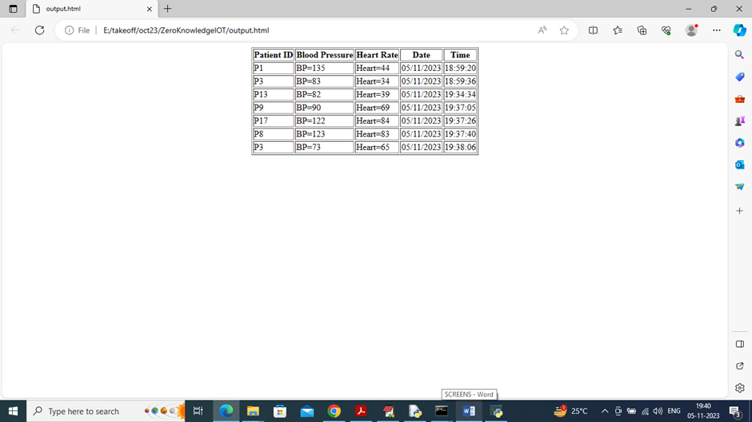
RESULT ANALYSIS
In above screen can see all patients details saved in Blockchain. Similarly by following above screens you can secure and store patient data in Blockchain and then read back

Slide 36
CONCLUSION
In conclusion, the integration of blockchain technology in the management of Internet of Things (IoT) devices within the medical industry presents a transformative opportunity to enhance data security, interoperability, and patient care. By leveraging the decentralized and immutable nature of blockchain, healthcare stakeholders can ensure the integrity and authenticity of sensitive patient data collected from various IoT devices.

Slide 37
FUTURE SCOPE
The integration of blockchain technology with the Internet of Things (IoT) in the medical industry holds significant promise for enhancing data management, security, and interoperability.
Blockchain can provide a decentralized and immutable ledger that ensures the integrity of medical data collected from IoT devices, reducing the risk of tampering or unauthorized access.

Slide 38
REFERENCES
1. Kouicem, D., M. A. K., & H. A. B. (2018). "Blockchain for Internet of Things: A Survey." IEEE Communications Surveys & Tutorials , 21(4), 3116 3145.
2. M. J. H. et al. (2020). "Blockchain Technology in Healthcare: A Comprehensive Review." IEEE Access , 8, 192569 192582.
3. Alcazar, J., & L. C. (2020). "Integrating IoT and Blockchain Technology for Smart Healthcare: A Review." Journal of Network and Computer Applications , 165, 102691.
4. Rehman, M. H. et al. (2020). "Blockchain based Secure Framework for Smart Healthcare System." IEEE Access , 8, 153453 153464.
5. Wang, Y., et al. (2019). "Blockchain Technology in Health Care: A Comprehensive Review and Directions for Future Research." Frontiers in Blockchain , 2, 6.

Slide 39
GITHUB LINK
https://github.com/mahesh8075/Blockchain-for-the-Management-of-IOT-devices-in-medical-industry

Slide 40
THANK YOU!!

